Slide 1
CLASSICAL MUSIC
Level: Intermediate/Upper Intermediate/ Advanced
Categories:
Vocabulary
Speaking Club

Slide 2
Information Page
Topic: Classical Music
Target Language: Vocabulary, General Discussion
Level: Intermediate/Upper Intermediate/Advanced
Duration: 45 min
Format: Offline Speaking Club

Slide 3
Classical Music
Intermediate/Upper Intermediate/Advanced

Slide 4
Introduction
Name?
Job?
Live?

Slide 5
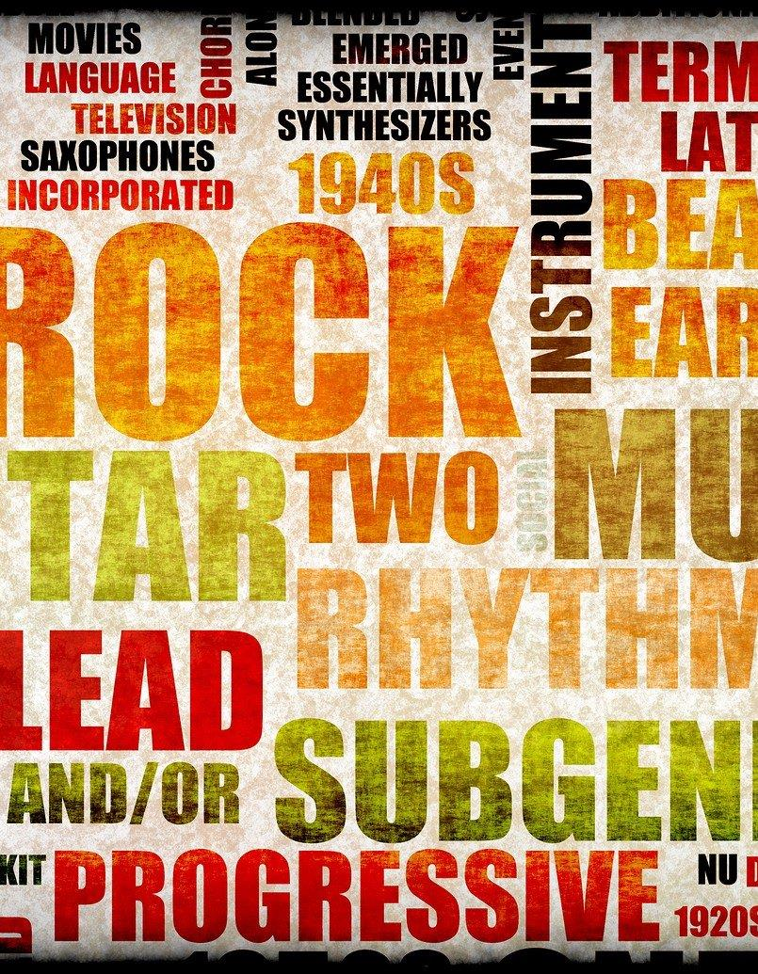
Music Genres
How often do you listen to music?
Where do you listen to music?
What music genres do you know about?
Which genres do you like? What music do you like? Why do you like it?
Notes:
Good opportunity to get students engaged in the class as all students like some type of music.
Give enough time for discussion and Open Class Feedback
5-7 min

Slide 6
Music Genres
Country
Electronic dance music (EDM)
Hip-hop
Indie rock
Jazz
K-pop
Oldies
Pop
Rap
Rhythm & blues (R&B)
Rock
Techno
Metal
Ballade

Slide 7
Discuss
What is classical music?
Do you ever listen to classical music?
Why is classical music different from other music?
What instruments do we use in classical music?
What music do you know? (Composer names?)
Do you think it is boring?

Slide 8
Classical Music - Definition
ˌklæsɪkl ˈmjuːzɪk/
​music written in a Western musical tradition
usually using a specific form (for example a symphony)

Slide 9
Match the words on the left with the words on the right
Orchestra
Symphony
Conductor
Composer
Musician
a person who writes music
someone who directs the performance of musicians or a piece of music
someone who is skilled in playing music, usually as a job:
a large group of musicians who play many different instruments together and are led by a conductor:
a long piece of music for an orchestra, usually with four movements (= parts)

Slide 10
Match the words on the left with the words on the right
Orchestra
Symphony
Conductor
Composer
Musician
a large group of musicians who play many different instruments together and are led by a conductor
a long piece of music for an orchestra, usually with four movements (= parts)
someone who directs the performance of musicians or a piece of music
a person who writes music
someone who is skilled in playing music, usually as a job:

Slide 11
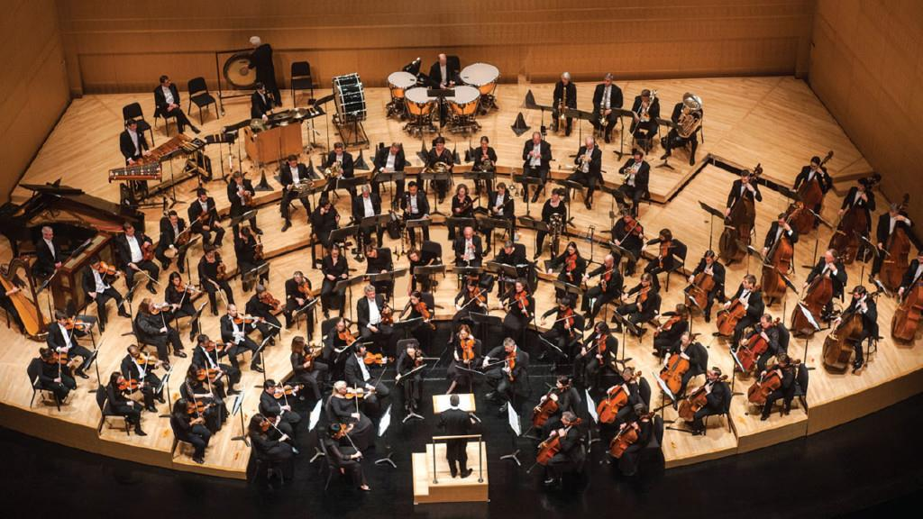
The orchestra

Slide 12
How many sections are there in an orchestra?

Slide 13
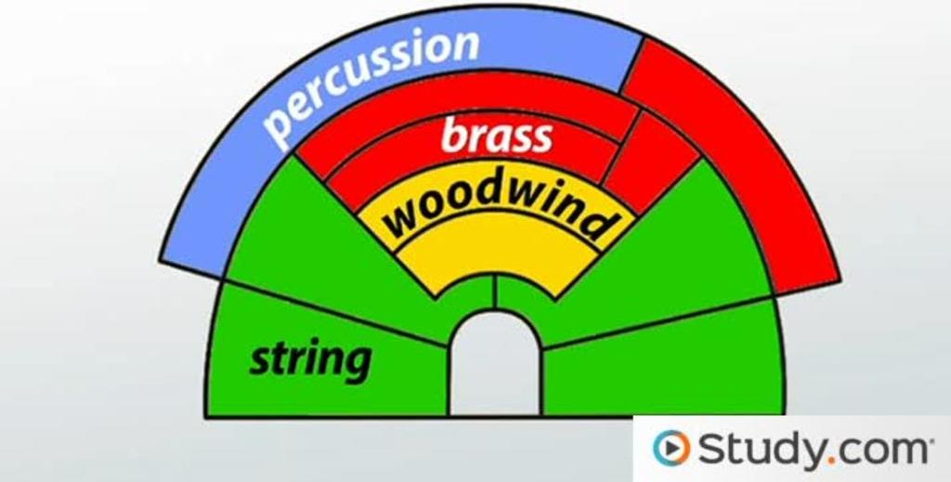

Slide 14
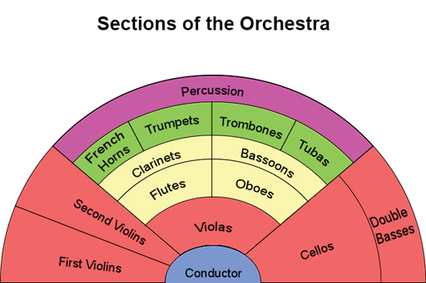

Slide 15
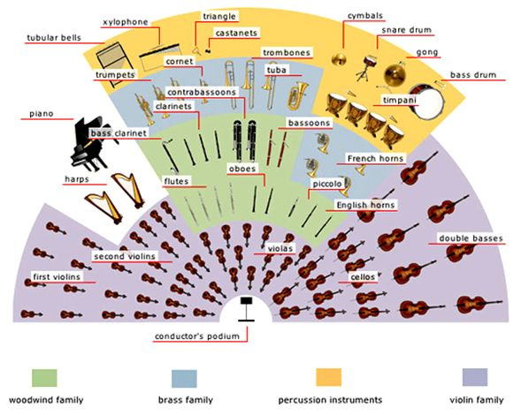

Slide 17
Discuss
If you could play in an orchestra, what instrument would you like to play? Why?
Have you ever seen an orchestra play in real life? What did you think?
Do you think young people like listening to classical music? Why not?
Where do we often year classical music? Which places? TV? Movies?

Slide 18
Composers

Slide 19
Which composers do you know of?
Make a list

Slide 20
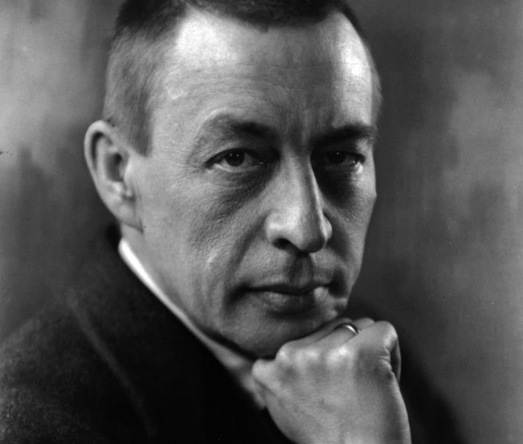
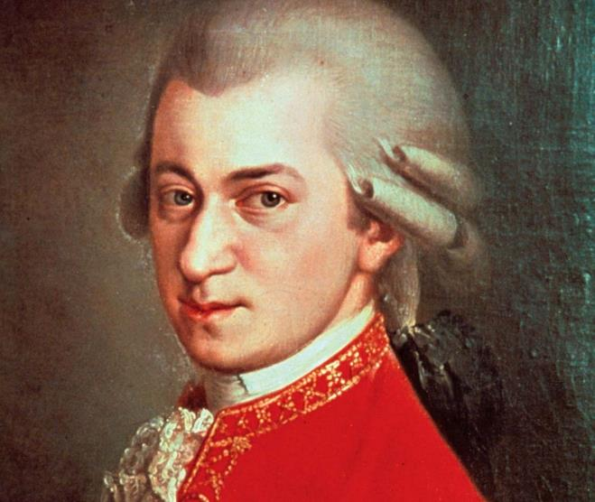
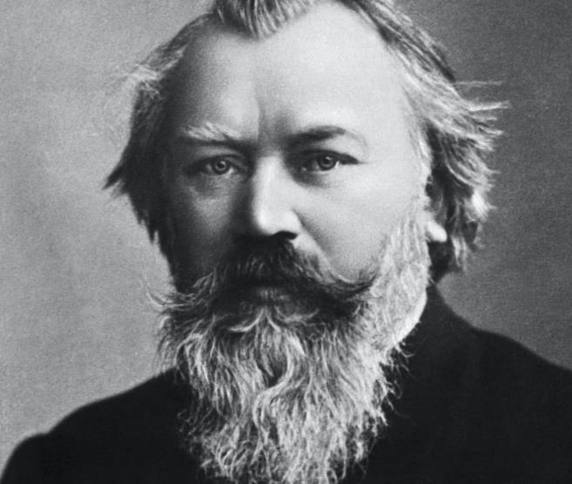
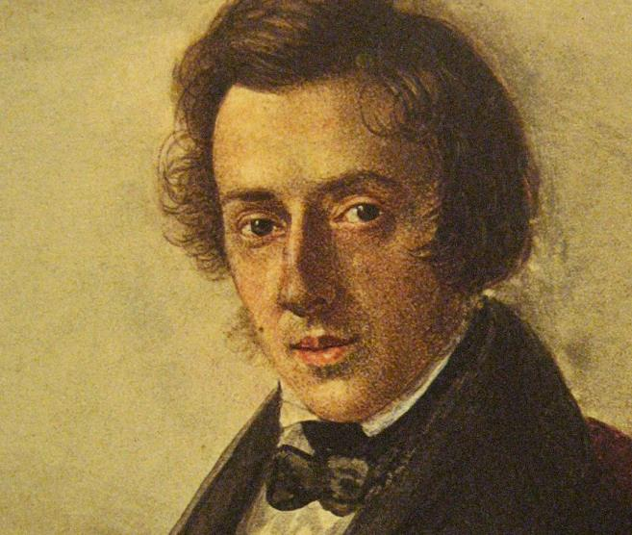
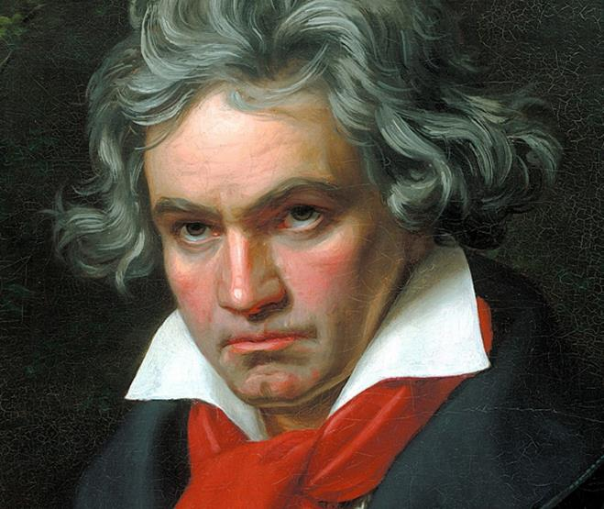
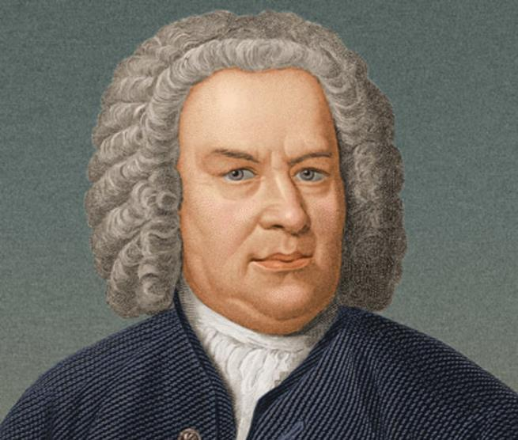
Rachmaninoff
Mozart
Brahms
Chopin
Beethoven
Bach

Slide 21
Music Appreciation Brahms: Hungarian Dance 5
What kind of occasion would be suitable for this kind of music?
How many people do you think were playing on this recording? Ten? Fifty? Two hundred?
What emotions could you associate with this piece?
What time of day might it be best to listen to this piece?
Did you visualize anything while listening? An image, a person, a narrative, a world?
How long do you think this piece took to write?
What would you say is the value of this music? Could it be called a ‘masterpiece’?

Slide 22
Thank You

Slide 23
CLASSICAL MUSIC
For more information go to:
www.eslpowerpoints.com
Or contact:
admin@eslpowerpoints.com for custom requests

