Slide 1
AT A SPORTS GAME
Level: Elementary/ Pre-Intermediate/ Intermediate
Categories:
Vocabulary
Speaking Club

Slide 2
Information Page
Topic: At a sports game
Target Language: Vocabulary
Level: Elementary/ Pre-Intermediate/ Intermediate
Duration: 1 hour
Format: PPT, Speaking Club

Slide 3
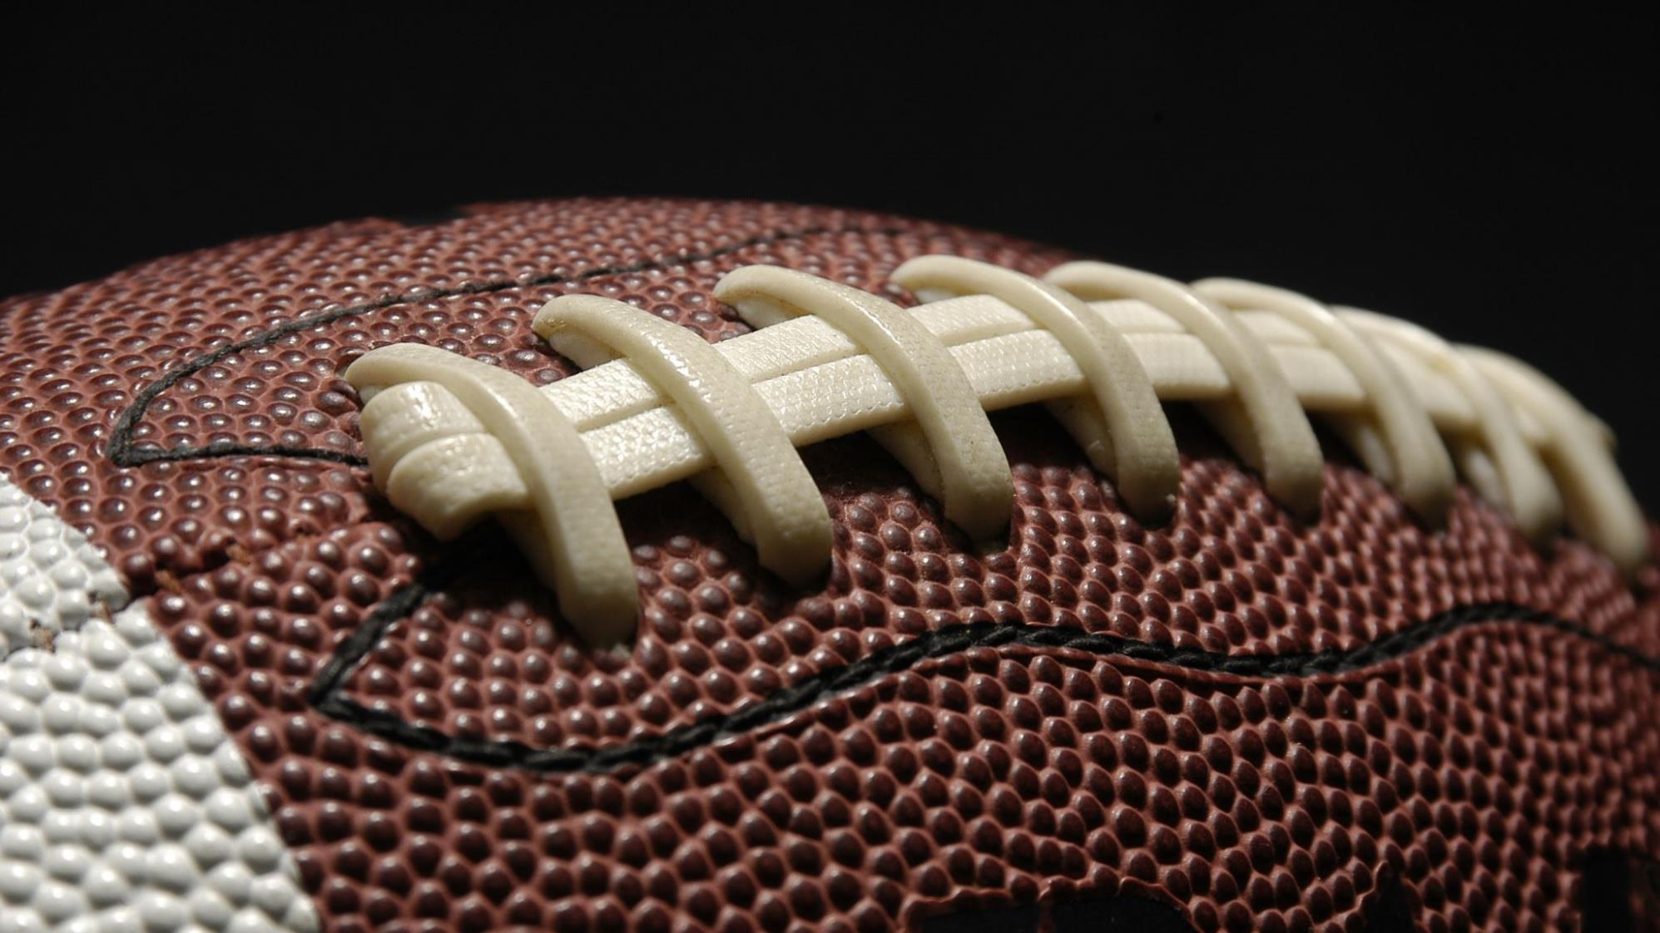
At a sports game
Pre-Intermediate/Intermediate/Upper-Intermediate

Slide 4
Introduction
Name?
Live?
Job?

Slide 5
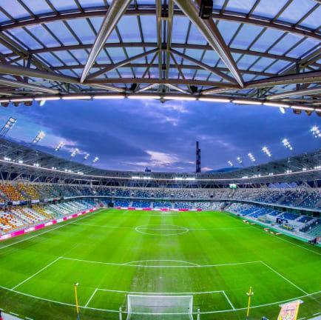
Discuss with your partner
When was the last time you watched a sports game at a stadium or on TV?
What sport did you watch?
What did you like about watching the game?
What didn’t you like about watching the game?
What sports game would you like to go to in the future?

Slide 6
Where can I play these sports? On a field or a court?
Soccer
Tennis
Basketball
Baseball
Volleyball
Badminton

Slide 7
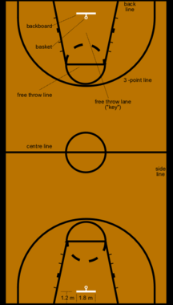
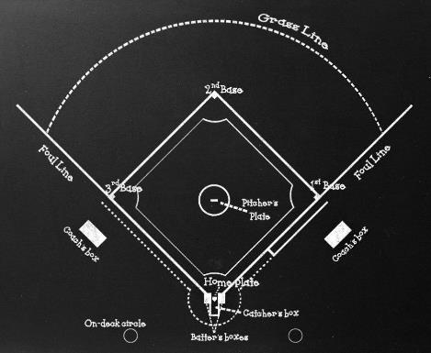
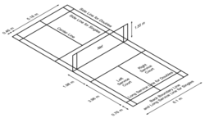
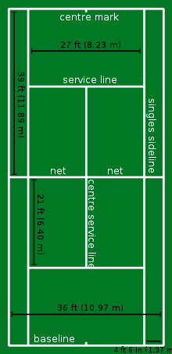
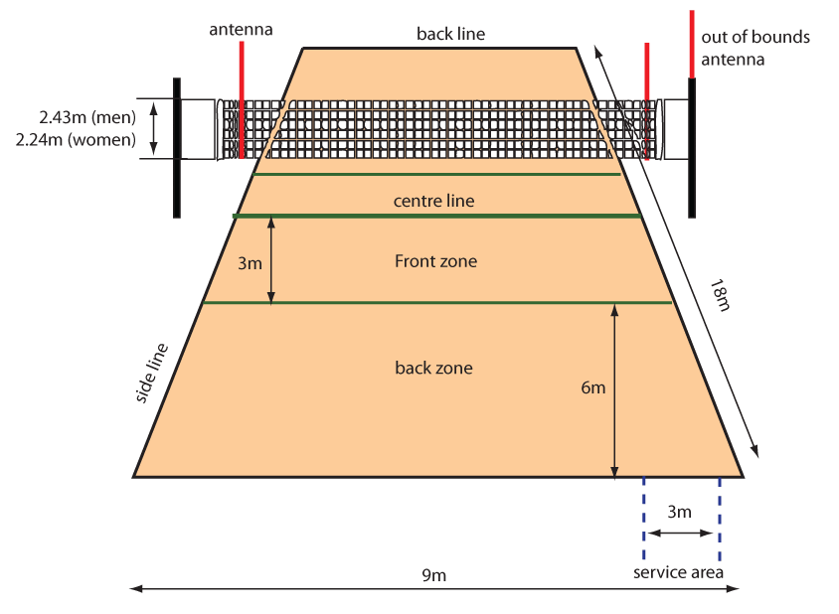
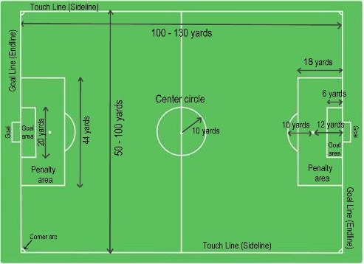
Badminton Court
Basketball Court
Baseball Field/Diamond
Soccer Field
Tennis Court
Volley Court

Slide 12
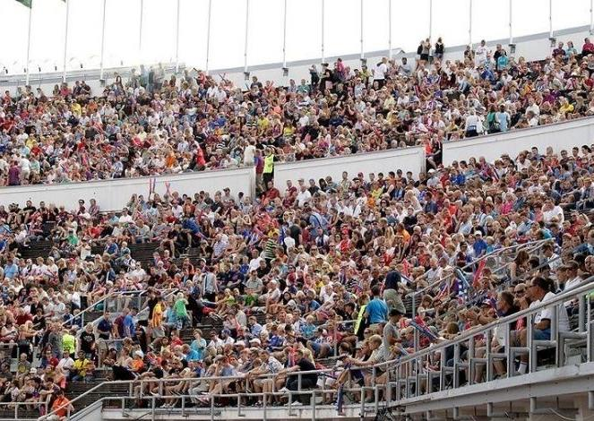
What do these words mean?
Umpire
Professional
Personal best
Blow the competition away
Trophy
Cheer on
Fan/Supporter
Warm up
Stadium
Spectators

Slide 13
Find the person that matches your word or definition
Umpire
Professional
Personal best
Blow the competition away
Trophy
Cheer on
Fan/Supporter
Warm up
Stadium
Spectators
Definitions at back of PPT for cutout
Notes:
Definitions at back of PPT – cut out
Students go around until they find their match. Depending on the size of the class each person can have one definition and one word.

Slide 14
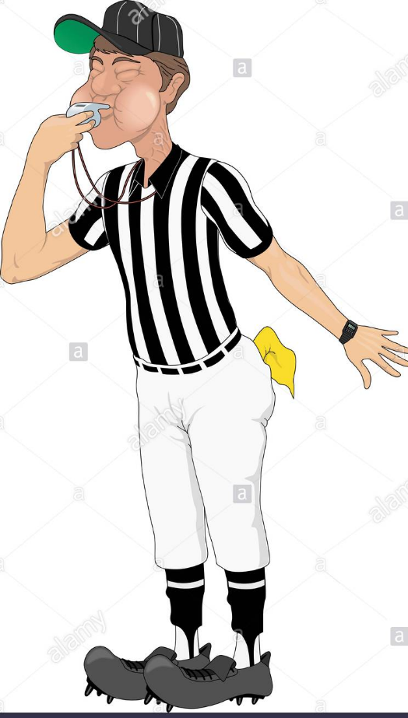
umpire /ˈʌmpaɪər/
a person whose job is to watch a game and make sure that rules are not broken

Slide 15
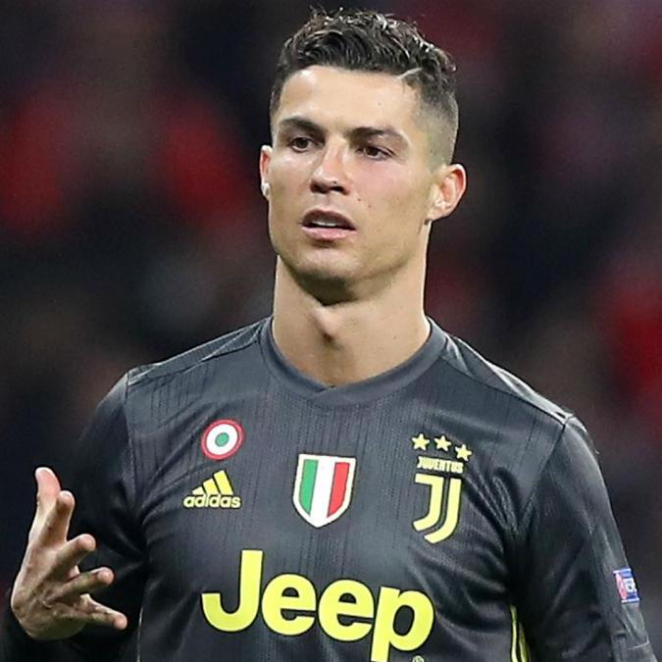
professional /prəˈfeʃənl/
doing something as a paid job rather than as a hobby

Slide 16
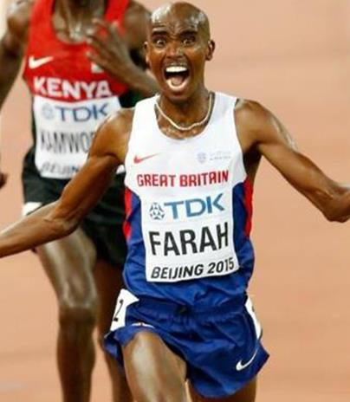
personal best
the best result that you have ever had in an event such as a race or other competition

Slide 17
blow the competition away
to be much better than the other team; beat them

Slide 18
trophy /ˈtrəʊfi/
an object such as a silver cup that is given as a prize for winning a competition

Slide 19
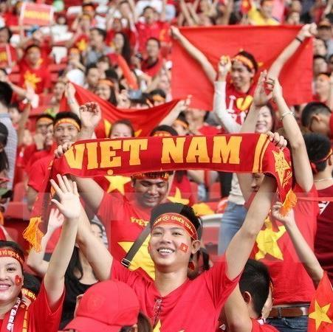
fan/ supporter
A person who supports a team, attends all the games and usually cheers up loudly.

Slide 20
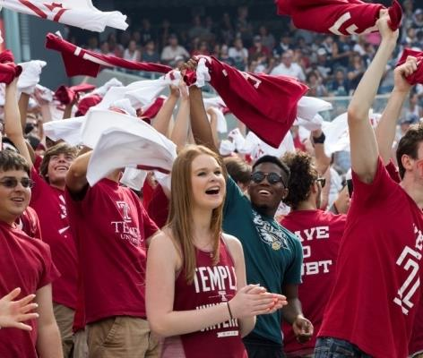
cheer on
to give shouts to encourage somebody in a race, competition, etc.

Slide 21
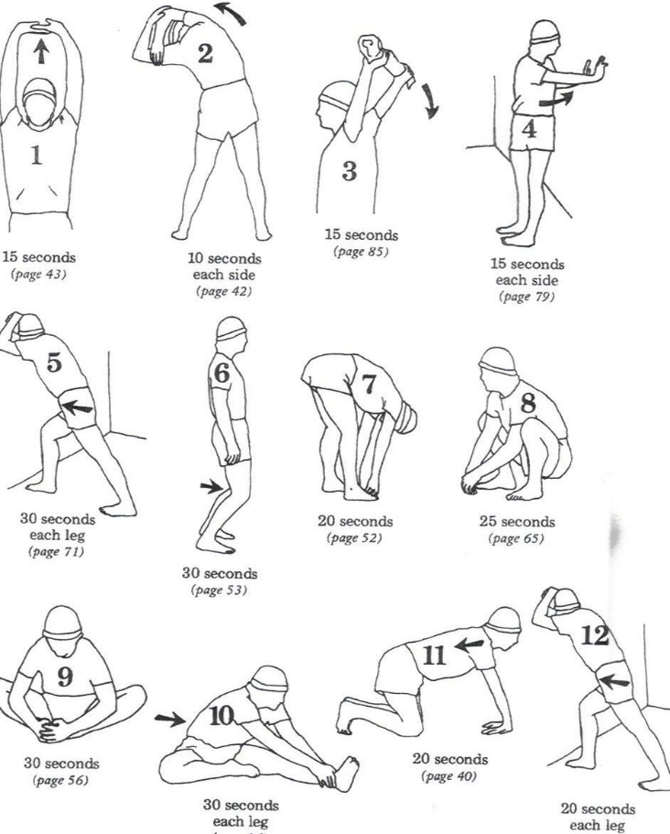
warm up
to prepare for physical exercise by doing gentle exercises or practice

Slide 22
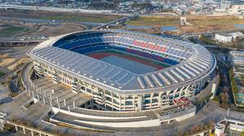
stadium
a large sports ground surrounded by rows of seats and usually other buildings

Slide 23
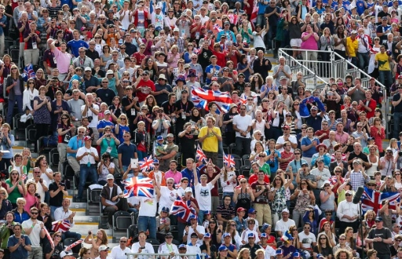
spectators
people who watch a sport

Slide 24
Fill the Gap
Umpire
Professional
Personal best
Blow the competition away
Trophy
Cheer on
Fan/Supporter
Warm up
Stadium
Spectators
There were many ___________________ at the game, but not a lot of Chelsea ____________________
The ___________ gave the player a red card.
Team A ___________________________ by beating team B 4:1.
He scored his __________ ___________ and won the _______________.
The players are __________ ___________ in the ___________
The fans were __________ _________ the team of ___________________ players.

Slide 25
Fill the Gap
spectators
Umpire
Professional
Personal best
Blow the competition away
Trophy
Cheer on
Fan/Supporter
Warm up
Stadium
Spectators
There were many ___________________ at the game, but not a lot of Chelsea ____________________
The ___________ gave the player a red card.
Team A ___________________________ by beating team B 4:1.
He scored his __________ ___________ and won the _______________.
The players are __________ ___________ in the ___________
The fans were __________ _________ the team of ___________________ players.
fans
umpire
blew the competition away
personal best
trophy
warming up
stadium
cheering on
professional

Slide 26
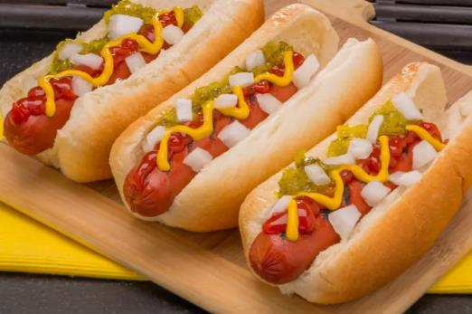
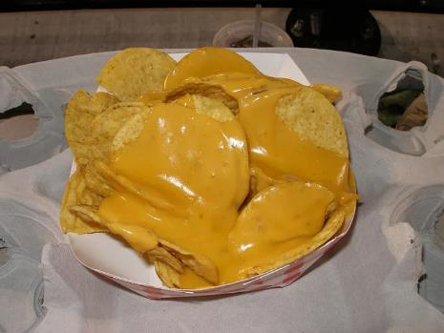
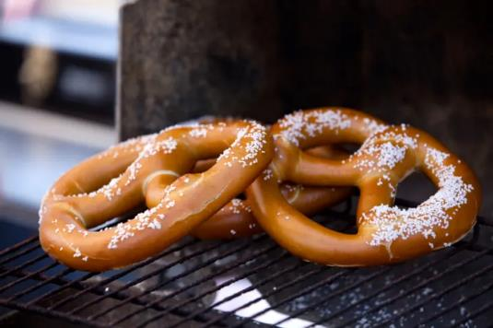
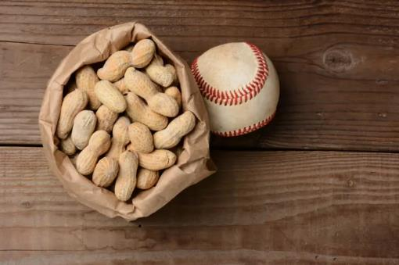
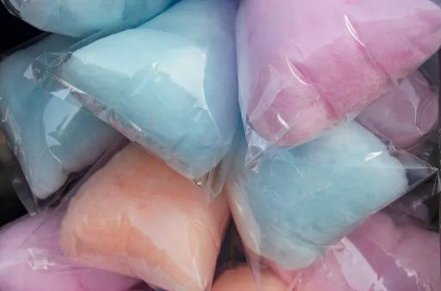
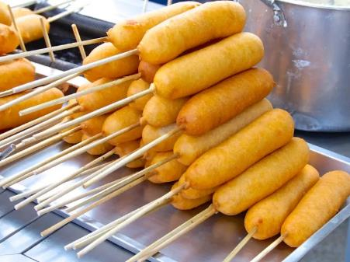
What can I buy at a sports game?
HOTDOGS
NACHOS
PRETZELS
PEANUTS
COTTON CANDY
CORNDOGS

Slide 27
Plan a day at a sports game.
What sport do you like?
What game are you going to watch?
What team are you going to support? Are you a fan? How do you show other people you are a fan?
Where are you going to watch the game?
Who are you going with?
What are you going to eat?
Now talk to 2 people about your plan.

Slide 28
Find someone who…..
Doesn’t like soccer
Is a Chelsea supporter
Has gone to a volleyball game
Knows a professional sports player
Is an umpire
Has won a trophy
Tries to improve their personal best in a sport
Often goes to a stadium
never warms up before doing exercises

Slide 29
Thank You

Slide 30
RESOURCES

Slide 31
Umpire
Professional
Personal best
Blow the competition away
Trophy
Cheer on
Fan/Supporter
Warm up
Stadium
Spectators

Slide 32
a person whose job is to watch a game and make sure that rules are not broken
to give shouts to encourage somebody in a race, competition, etc.
doing something as a paid job rather than as a hobby
the best result that you have ever had in an event such as a race or other competition
to be much better than the other team; beat them
an object such as a silver cup that is given as a prize for winning a competition
A person who supports a team, attends all the games and usually cheers loudly.
people who watch a sport.
to prepare for physical exercise or a performance by doing gentle exercises or practice
a large sports ground surrounded by rows of seats and usually other buildings

Slide 33
AT A SPORTS GAME
For more information go to:
www.eslpowerpoints.com
Or contact:
admin@eslpowerpoints.com for custom requests

