Slide 1
DOG LOVER’S DAY
Level: Elementary/ Pre-Intermediate/
Intermediate
Categories:
Vocabulary
General Discussion

Slide 2
Information Page
Topic: Dog Lover’s Day
Target Language: Dog Breeds, How to take care of your dog, etc.
Level: Elementary, Pre-intermediate, Intermediate
Duration: 1 hour
Format: Offline/online Speaking club with teaching notes

Slide 3
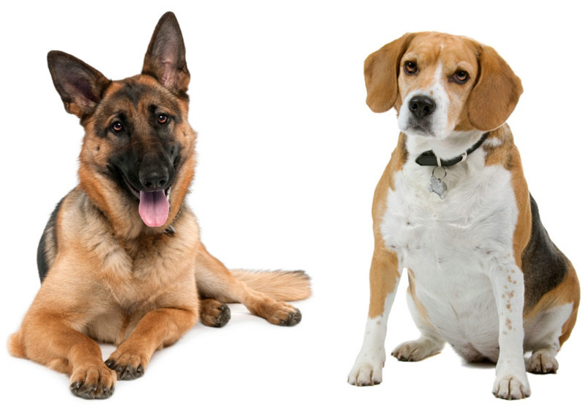
Dog Lover's Day
ELEMENTARY/ Pre-intermediate/ Intermediate

Slide 4
Introduction
Name?
Live?
Job?
Do you like dogs? Why? Why not?

Slide 5
Discuss with your partner
Have you ever owned a dog?
What type of dog was it?
Was it difficult to take care of your dog? Why?
Would you want to own a dog in the future?

Slide 6
What are advantages and disadvantages of having a dog?
Advantages
Disadvantages
Loyal friend (Best friend)
Companion/Love
Fun
Security
Guide Dogs
You have to take care of your dog
Noisy
Dangerous
Dirty

Slide 7
What dog breeds do you know about?
Make a list

Slide 8
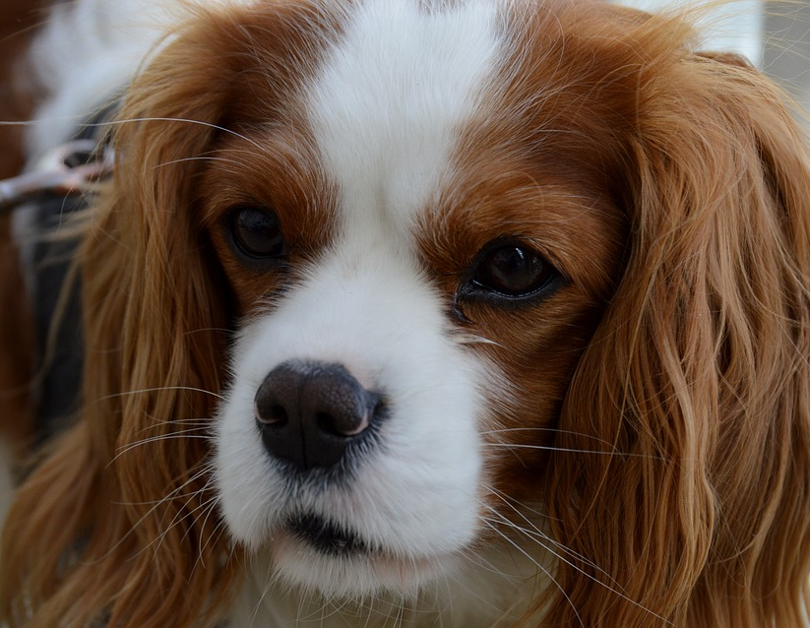
Popular Dog Breeds

Slide 9
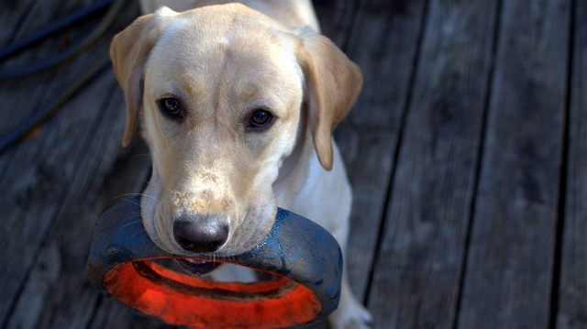
Labrador Retriever

Slide 10
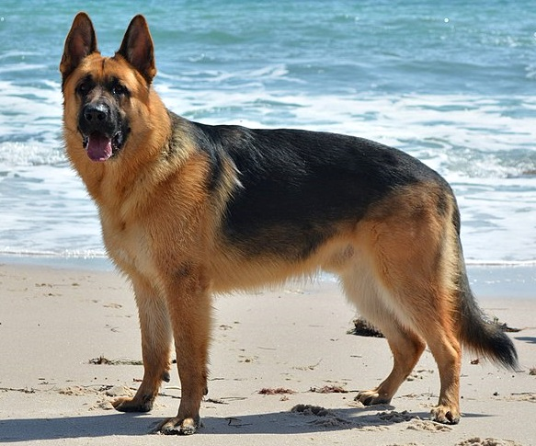
German Shepherd

Slide 11
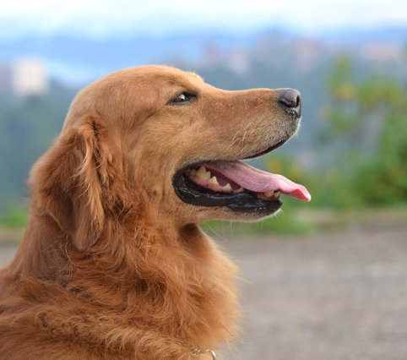
Golden Retriever

Slide 12
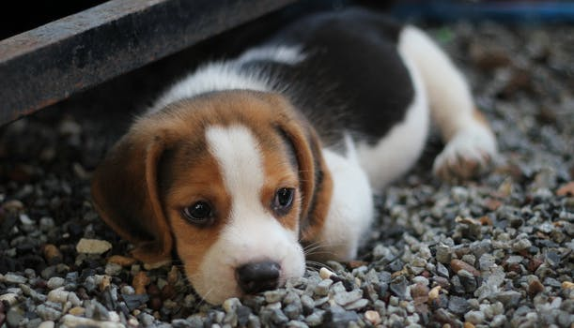
Beagle

Slide 13
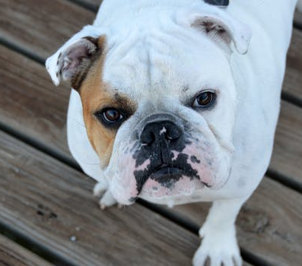
English Bulldog

Slide 14
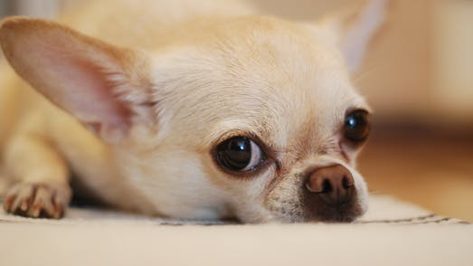
Chihuahua

Slide 15
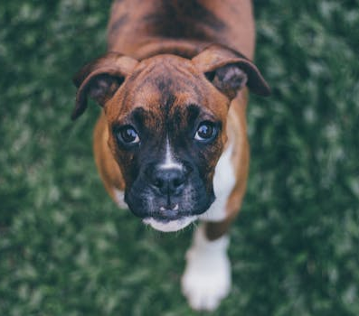
Boxer

Slide 16
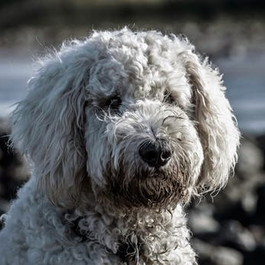
Poodle

Slide 17
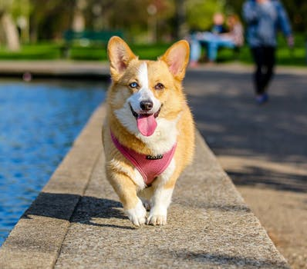
CORGI

Slide 18
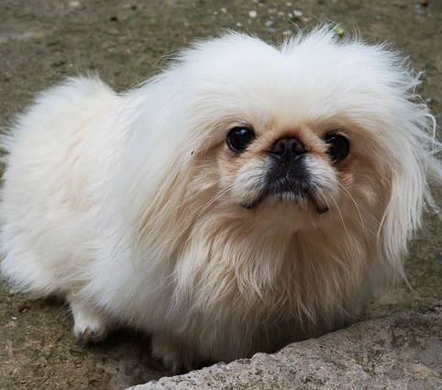
Pekingese

Slide 19
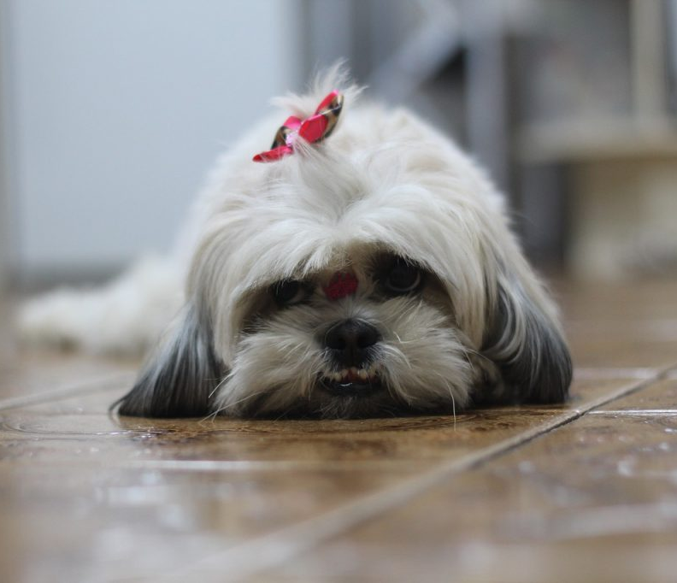
Shih Tzu

Slide 20
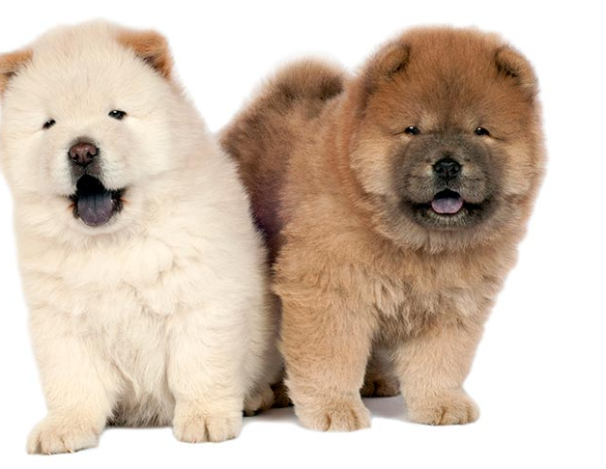
Chow Chow

Slide 21
What must I do to take care of a dog?
Play with your dog
Feed your dog
Wash your dog
Walk and exercise your dog
Give your dog a lot of love

Slide 22
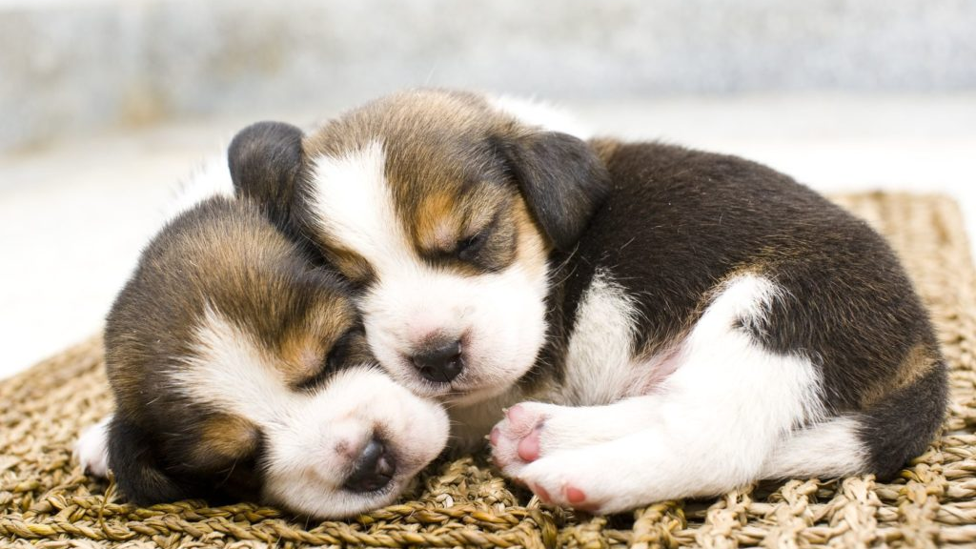
Tips to take care of your dog

Slide 23
Living Space
Clean
Safe

Slide 24
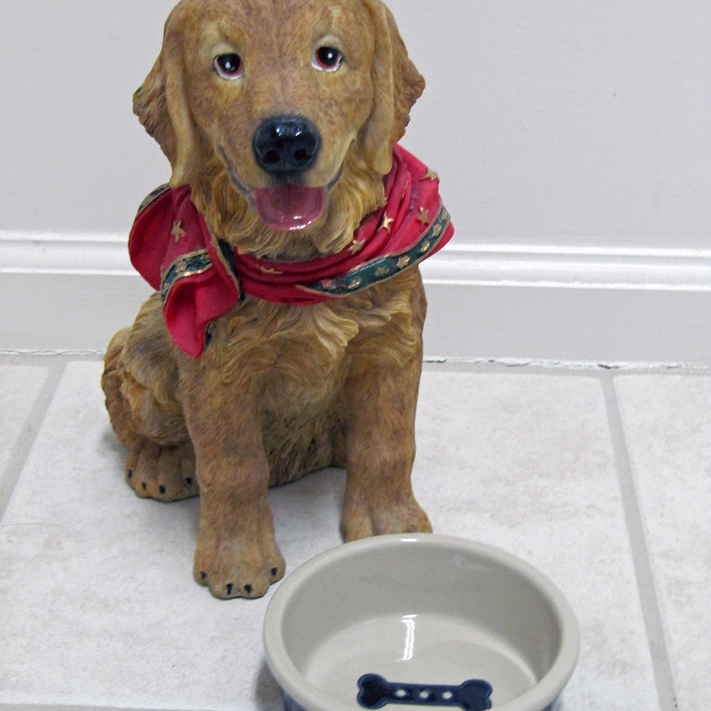
Feeding your dog
What food is good for your dog?
What food is bad for your dog?
When do you feed your dog?
Where do you feed your dog?
How much do you feed your dog?
This Photo by Unknown author is licensed under CC BY-ND.

Slide 25
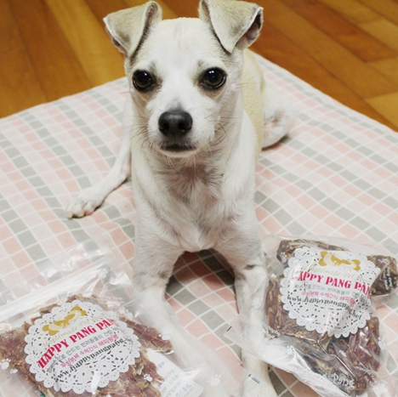
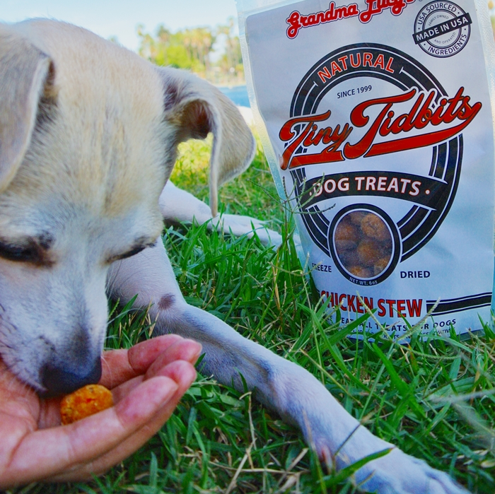
Tips for feeding your dog
Always provide your dog with clean water
Make sure the environment is safe.
Don't overfeed your dog.
Provide your dog with quality dog food
Don't feed him human food. That will cause obesity.
This Photo by Unknown author is licensed under CC BY-NC-ND.
This Photo by Unknown author is licensed under CC BY-NC-ND.

Slide 26
Keeping your dog healthy
How often should you take your dog for a walk?
How often do you go to the veterinarian?
Do you give your dog supplements (vitamins, etc.)?
How often do you groom your dog?

Slide 27
Tips for Keeping your dog healthy
Walk your dog as often as possible. (Bigger dogs need exercise twice a day; 30 – 60 min)
Take your dog to the veterinarian at least once a year
Give your dog the correct supplement.
Wash your dog regularly

Slide 28
What do I need to take care of a dog?
Make a list

Slide 29
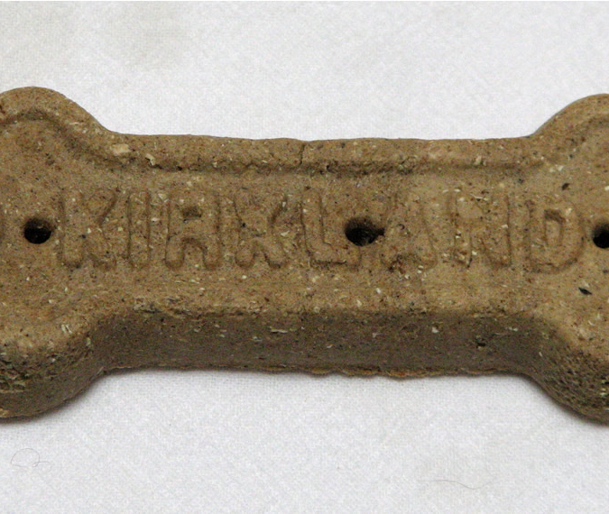
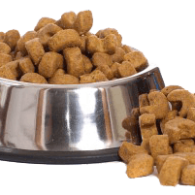
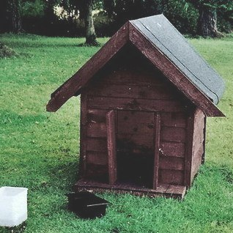
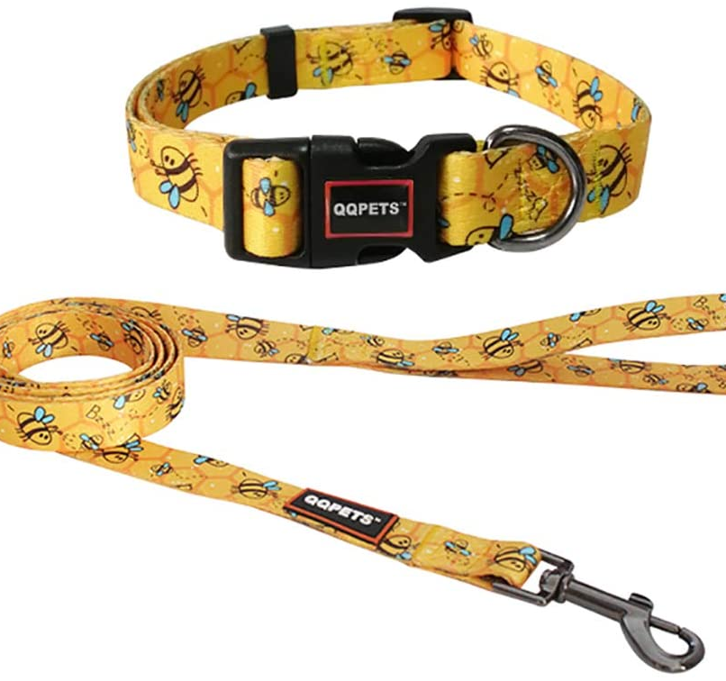
Match
Kennel
Dog food
Leash and collar
Dog Biscuits
This Photo by Unknown author is licensed under CC BY-SA.
This Photo by Unknown author is licensed under CC BY-NC.
This Photo by Unknown author is licensed under CC BY-SA.

Slide 30
Getting a dog
You are planning to get a dog. Discus the following questions with your partner:
What dog do you want? Why?
Where will you get your dog? Animal shelter? Pet Store? Friend?
What will you do first?
What will you teach the dog?
Where will your dog eat and sleept?
How will take care of the dog?

Slide 31
Starting a Dog Club
You and your friends are starting a dog club.
Answer the following questions
Where will you meet?
What activities will you have for the dogs.
What will you call your club?
How will you advertise your club?
Other?
Notes:
Extension: Number students and regroup. Each students share what they decided with new group

Slide 32
Thank You

Slide 33
Dog Lover’s Day
For more information go to:
www.eslpowerpoints.com
Or contact:
admin@eslpowerpoints.com for custom requests

